Slide 1

Predictive and Prescriptive Analysis Project Presentation
Faculty : Alekh Gour
Presented by:
Group 5
Shiwang Agarwal | B2021041
Sarthak Kumar Bal | B2021039
Parag Agrawal | B2021029

Slide 2
INTRODUCTION
AGENDA
OBJECTIVE
THE WHOLE IDEA BEHIND CHOOSING THIS DATASET IS TO FIGURE OUT THE IMPORTANT FACTORS WHICH CAN CREATE HUGE IMPACT ON AUTOMOBILES BUSINESS RIGHT FROM SETTING UP THE BUSINESS TO DELIVERY OF CAR TO THEIR CUSTOMERS.
THE COMPLETE AIM IS TO APPLY DATA SCIENCE TECHNIQUES FOR PREDICTING THE PRICE OF CARS WITH THE AVAILABLE INDEPENDENT VARIABLES(THE MATERIALS USED FOR DESIGNING OF CAR). THAT SHOULD HELP THE MANAGEMENT TO UNDERSTAND HOW EXACTLY THE PRICES VARY WITH CHANGE IN INDEPENDENT VARIABLES.
MOST OF THE TIMES, COMPANIES FACES ISSUES ON DETERMINING THE RIGHT PRICE FOR THEIR AUTOMOBILES ON BASIS OF THEIR CONSTRUCTION AND HENCE THE MODEL HAS BEEN CREATED TO HELP THE INDUSTRIES DETERMINE THE RIGHT PRICE FOR THEIR CONSUMERS.
WITH HELP OF THE BUILT MODEL, THEY CAN ACCORDINGLY MANIPULATE THE DESIGN OF THE CARS AND THE BUSINESS STRATEGY TO MEET CERTAIN PRICE LEVELS.

Slide 3
PROBLEM STATEMENT
THROUGH SUPPORT OF OUR MODEL, WE ARE TRYING TO RESOLVE A PROBLEM WHERE THE COMPANY CAN INPUT THE DIFFERENT POSSIBLE VARIABLES WHICH ARE BASICALLY THE DETAILS OF THEIR NEW CAR TO BE MANUFACTURED AND CAN GET A BEST POSSIBLE BASE PRICE FOR THAT TO WITH BE LAUNCHED IN THE MARKET.
IN THIS MODEL :
WE HAD CLEANED THE DATASETS
APPLIED CORRELATION
DUMMY ENCODING
EXTRACTED TARGET AND FEATURES VARIABLES BUILT A MODEL TO GET THE OUTPUT OF PRICE WITH HELP OF DIFFERENT SUPPORTING INPUTS.
THIS MODEL WILL HELP COMPANY IN:
MINIMIZING THE DECISION EFFORTS IN ORDER TO REDUCE THEIR OPERATING COST FOR THEIR AUTOMOBILES
CAN GET AN EFFECTIVE PRICE WHICH CAN BE LATER ON ADJUSTED BASED ON LOCATION, TAXES AND OTHER FACTORS.

Slide 4
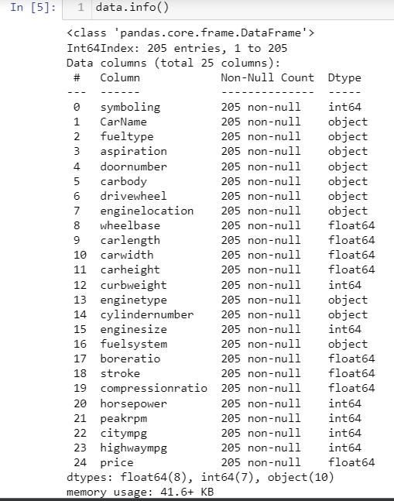
CAR PRICE PREDICTION DATASET INFORMATION
DATASET CONTAINS 25 FEATURES
DATASET IS COMBINATION OF 10 CATEGORICAL VARIABLES AND 15 NUMERICAL VARIABLES
DATASET CONTAINS MISSING VALUES IN WHEELBASE AND CARWIDTH

Slide 5
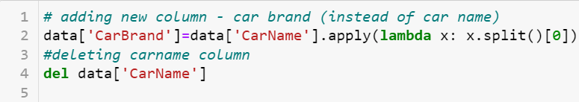

PREPROCESSING OF DATASET INFORMATION
REPLACING CARNAME TO CARBRAND TO MAKE TO MORE APPEALING, AND DROPPING CARNAME FEATURE
REPLACING MISSING VALUES WITH MEAN OF THAT FEATURE
REPLACING CATEGORICAL TO NUMERICAL DATA
REMOVING DUPLICATES

Slide 6
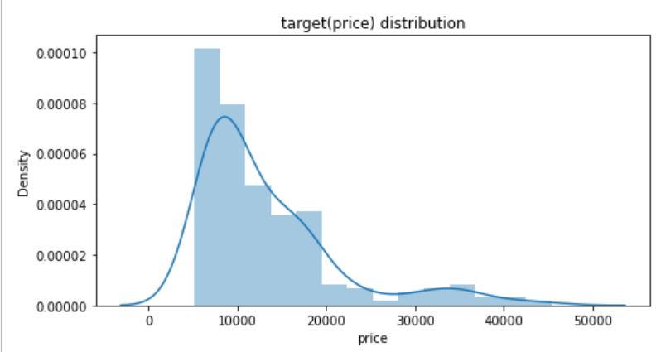
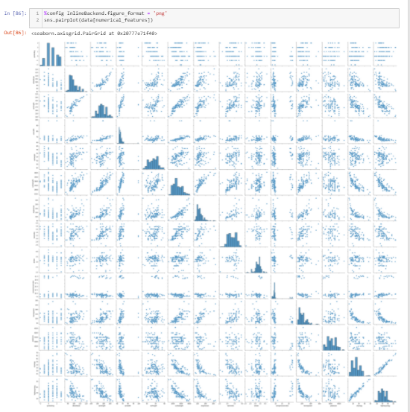
CAR PRICE PREDICTION DATASET ANALYSIS
PRICE DATA IS RIGHT SKEWED
PAIR PLOT HELP US TO SEE BOTH DISTRIBUTION OF SINGLE VARIABLES AND RELATIONSHIPS BETWEEN TWO VARIABLES
IT SHOWS SKEWED AND NORMALLY DISTRIBUTED DATASET

Slide 7
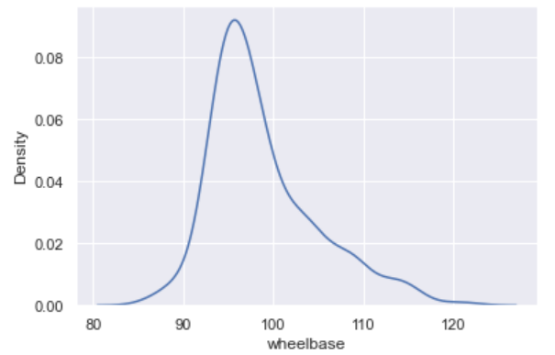
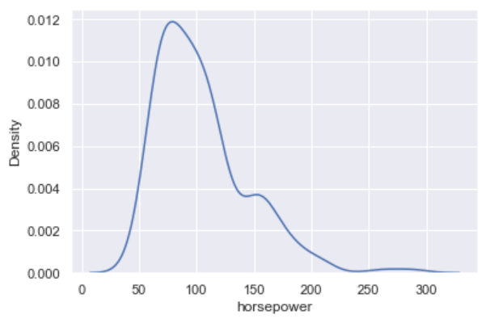
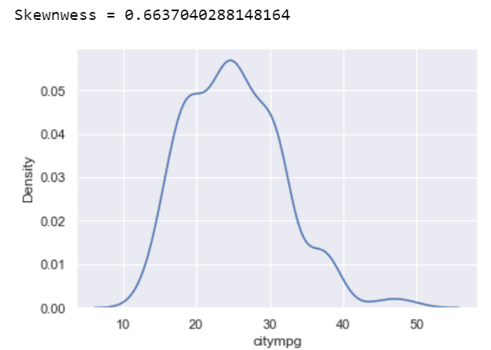
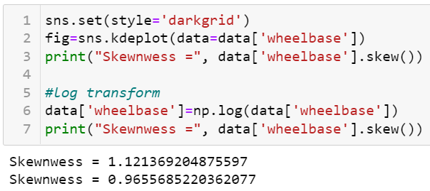
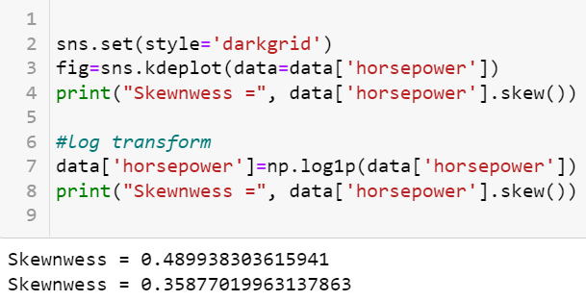
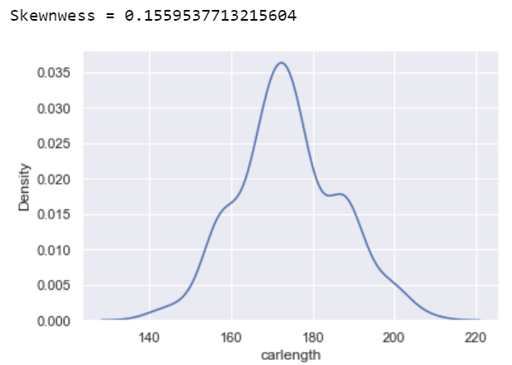
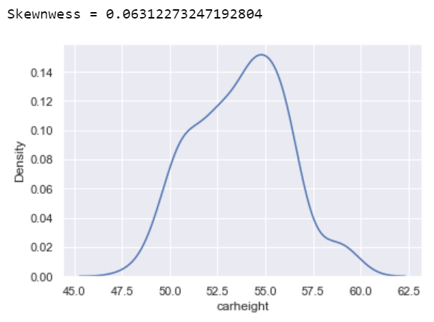
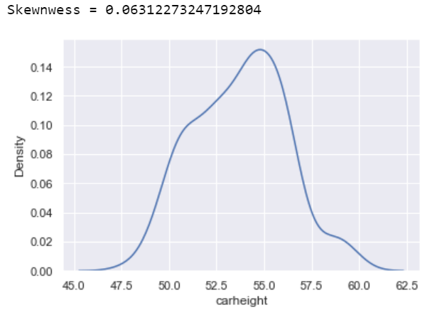
OUTLIER INFORMATION

Slide 8
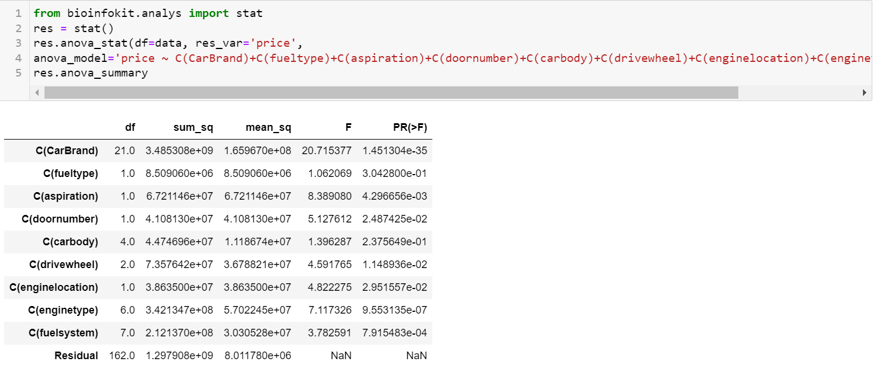
CATEGORICAL COLUMNS DISTRIBUTION ANALYSIS THROUGH ANOVA
CARBODY AND FUELTYPE HAVE P VALUE> 0.05 OTHER THAN ALL CATEGORICAL FEATURES HAVE P VALUE LESS THAN 0.05

Slide 9
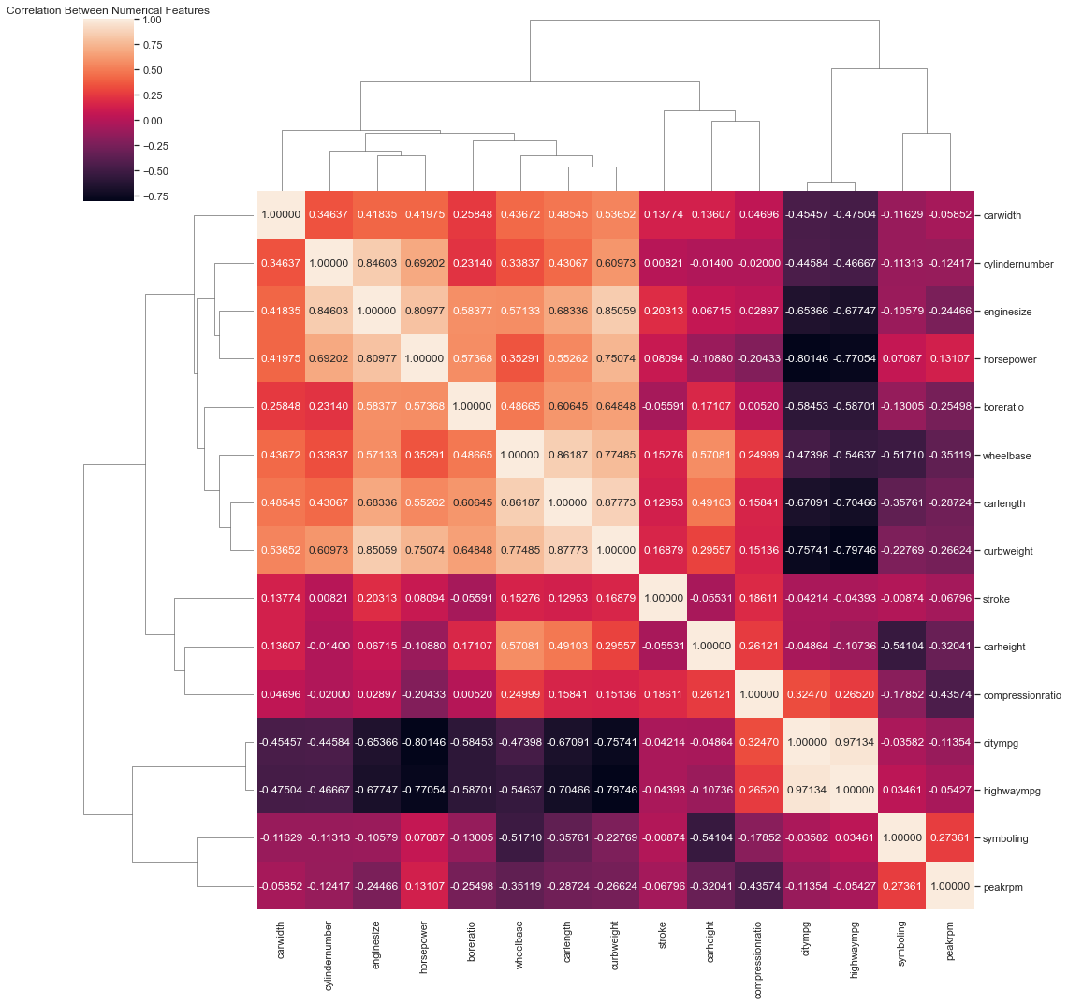
CORRELATION OF DATASET INFORMATION
CORRELATION IDENTIFIES VARIABLES AND LOOKS FOR RELATIONSHIP BETWEEN THEM
Highwaympg and citympg => 0.97
Enginesize and Curbweight => 0.88
Carlength and Curbweight => 0.87
Carlength and enginesize => 0.73
Wheelbase and carlength => 0.86
Citympg and Horsepower => -0.87
Horsepower and Highwaympg => -0.85
Horsepower and Curbweight => 0.78

Slide 10


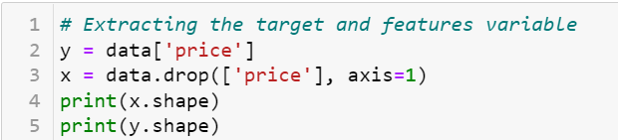
DUMMY ENCODING AND EXTRACTING TARGET AND FEATURE VARIABLE
WE HAVE DROPPED FEATURES WITH HIGH CORRELATION AND GOING FOR MULTIPLE REGRESSION
ENCODING ALL CATEGORICAL VARIABLES THROUGH ONE HOT ENCODING
EXTRACTING THE TARGET AND FEATURE VARIABLES

Slide 11
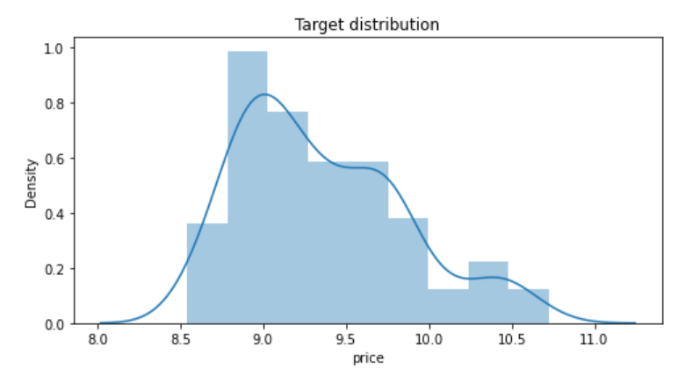
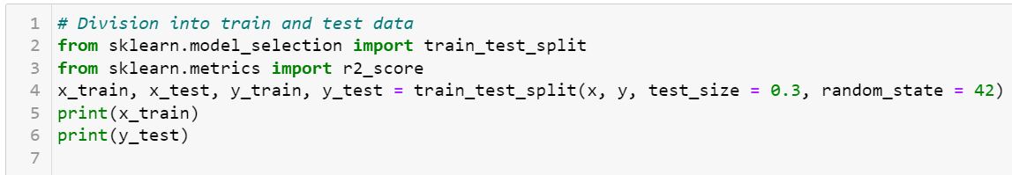

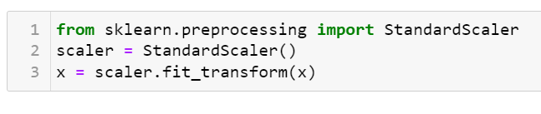
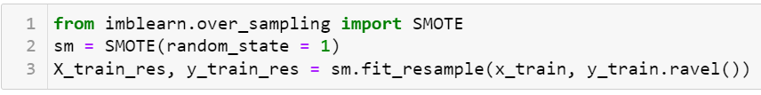
TRANFORMING TARGET VARIABLE, SCALING THE VARIABLES AND BUILDING THE MODEL
SPLITING DATA INTO TRAINING AND TESTING
DEALS WITH DATA IMBALANCING( LIKE COMPRESSIONRATIO)
STANDARDSCALER SCALES EACH FEATURE/VARIABLE TO UNIT VARIANCE.

Slide 12
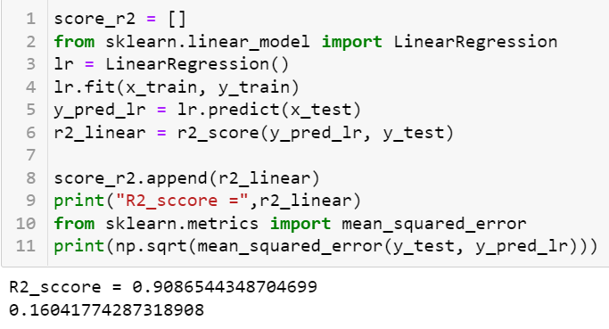
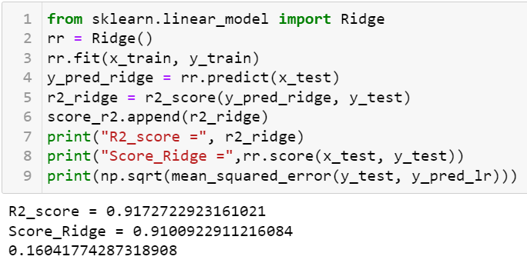
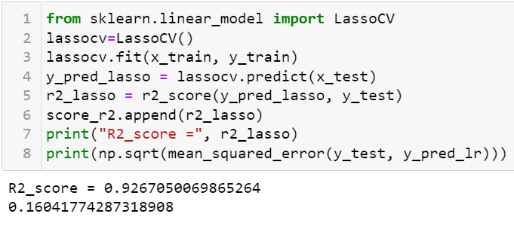
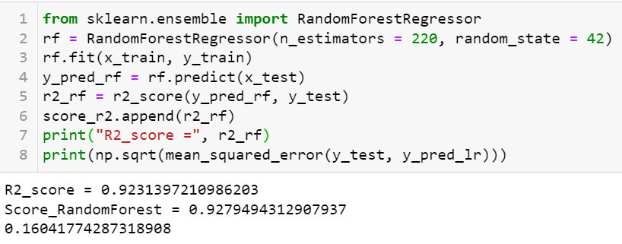
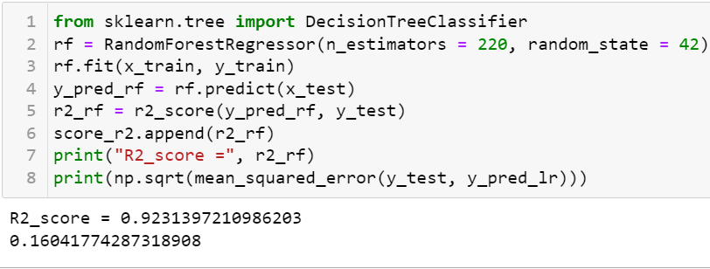
MODELS

Slide 13
OBSERVATIONS
CARBODY AND FUELTYPE HAVE P VALUE> 0.05 OTHER THAN ALL CATEGORICAL FEATURES HAVE P-VALUE LESS THAN 0.05
IMPUTING CYLINDERNUMBER WITH RESPECTIVE NUMBER GIVE BAD MEAN SQUARED ERROR FOR ALL MODELS ALSO R SQUARED ALSO CHANGED FOR ALL MODELS
CITYMPG, CARLENGTH AND WHEELBASE SHOWED GOOD CORRELATION AMONG EACHOTHER AND REMOVING THEM FROM MODEL HAVE SHOWN GOOD PREDICTION
AFTER REMOVING CARBODY FEATURE FROM CATEGORICAL DATA BY PERFORMING ANOVA, WE FOUND LASSOCV PERFORMED AS THE BEST MODEL( INDICATING IT WAS RESPONSIBLE FOR MULTICOLLINEARITY)
USING STANDARD SCALAR, ANOVA AND SMOTE(IMBALANCE TECHNIQUE) WE ANALYSED VERY LESS OVERFITTING, OUTLIERS AND DATA IMBALANCE ISSUES, AND LEADING ABLE TO PREDICT BETTER MODELS

Slide 14
REFERENCES:
https://www.kaggle.com/datasets?search=car+price+prediction

Slide 15
THANK YOU

